Slide 1
CEPOL
Facts and figures
EUROPEAN UNION AGENCY FOR LAW ENFORCEMENT TRAINING
1

Slide 2
What is CEPOL?
CEPOL is an Agency of the European Union whose core business is to train law enforcement officials in the EU Member States.
It is headed by an Executive Director, accountable to a Management Board made up of representatives from the EU Member States and the European Commission.
CEPOL has dedicated National Units (CNUs) in 26 Member States to provide information and assistance to law enforcement officials who wish to participate in CEPOL’s activities.

Slide 3
CEPOL Mandate
CEPOL Mandate

Slide 4
Core Objectives/1
To support, develop, implement and coordinate training for LE officials
Prevention and fight against serious crime and terrorism
Maintenance of public order (e.g. international policing of major events)
Planning and command of Union missions and capacity building in 3rd countries
CEPOL Mandate I
4

Slide 5
Core Objectives/2
Protection of human rights and fundamental freedoms in the context of law enforcement
Raise awareness around Union bodies, in particular Europol, Eurojust & Frontex
To support the implementation and use of International and Union instruments on LE cooperation
CEPOL Mandate II
5

Slide 6
CEPOL Mandate III
Tasks
To support, implement and develop: residential activities, exchange programs, online learning
To promote mutual recognition on LE training
To design, develop and implement training curricula
Multi annual STNA & training programs
An Electronic Network supports, enhances & completes training activities & learning products
6

Slide 7
CEPOL
2017 Key achievements
EUROPEAN UNION AGENCY FOR LAW ENFORCEMENT TRAINING
7

Slide 8
Successful in delivery
Responded to evolving political priorities by relevant training activities.
Trained LE officers on issues vital to the security of the EU & its citizens.
Its training activities reflected on sharing of knowledge & best practices, development of a common European LE culture.
In the course of 2017, CEPOL:

Slide 9
2017 Training Portfolio
105 residential activities
8 online courses
95 webinars
34 online modules
CEPOL Exchange Programme

Slide 10
Evolution of participation in CEPOL activities

Slide 11
Satisfaction with CEPOL activities

Slide 12
2017 priority topics
Public order – policing of major events
Research and prevention
Counterterrorism
Leadership, language development, train the trainers
Specific areas and instruments
LE cooperation & information exchange
Planning & command of Union missions
Fundamental rights
The EU Policy Cycle
12

Slide 13
Courses on the EU Policy Cycle
10 314 law enforcement officers trained
36 residential activities attended by 1148 participants
43 online activities (38 webinars, 5 online courses) with 8 975 participants
191 CEP exchanges
EU Policy Cycle topics encompassed 30% of CEPOL’s trainings in 2017

Slide 14
Courses on the EU Policy Cycle

Slide 15
19 CEP exchanges
3 webinars &
1 online module followed by
600 participants
8 residential activities attended by 290 participants
Migration
Training activities addressed the issues of:
misuse of migration flows for terrorism
foreign fighters and returnees,
radicalisation
909 LE officers trained
15

Slide 16
Cybercrime
11 residential activities attended by 317 participants
14 webinars & 2 online modules followed by 4 091 participants
27 training activities
42 CEP exchanges
In 2017, CEPOL’s cybercrime training portfolio comprised of:
4 450 LE officers trained
16

Slide 17
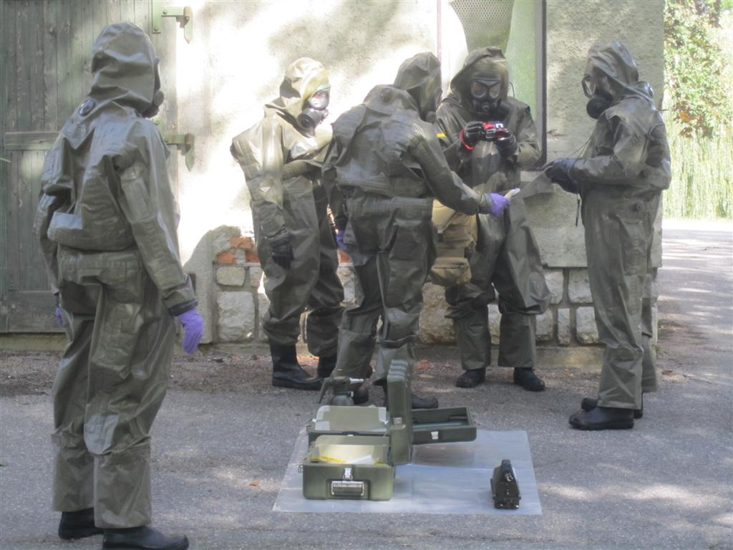
Courses on counter terrorism
CEPOL Knowledge Centre on Counter Terrorism:
Established in 2017
Aims to increase the impact of training in this key area
1098 participants trained
9 residential activities with 328 attendees
4 webinars & 2 online modules with 733 participants
37 CEP exchanges

Slide 18
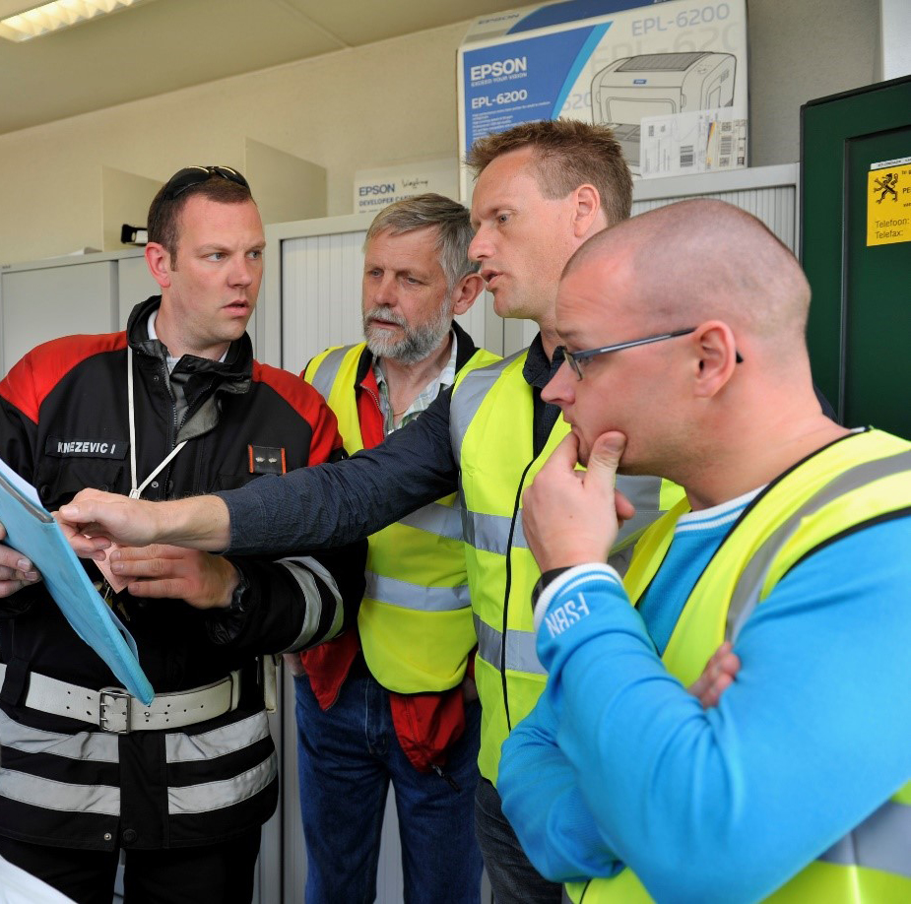
Courses on Common Security Defence Policy Mission Training (CSDP)
CEPOL Knowledge Centre on CSDP Missions:
245 participants trained
6 residential activities with 157 attendees
1 webinar with 85 attendees
3 CEP exchanges
Established in 2017
Aims to increase the impact of training in this key area

Slide 19
Common Security Defence Policy Mission Training (CSDP)
Aim: to prepare LE staff for deployment in CSDP missions
(in cooperation with Member States, EEAS, ESDC)
4 new course curricula developed
Tackle organized crime & corruption
Management & Leadership in diverse environment
Change Management
Strengthening
human rights
20
26

Slide 20
EU Strategic Training Needs Assessment (EU-STNA)
Methodological Study to Develop STNA in the Framework of the LETS Implementation (Q2 2017)
Draft Methodology
(07/2017)
Step 1 of the pilot project - Desk research
(Q4 2017)
Step 2-3 - Expert consulta- tions
(Q1 2018)
Finalisation of the first EU-STNA cycle
(Q4 2018)

Slide 21
European Joint Master Programme (EJMP)
Fully accredited program
First programme
10/2015 – 10/2017
26 Graduates
Further qualifies LE officers on implementation & operationalisation of EU Instruments
Second programme
10/2017 – 10/2019
30 participants

Slide 22
598 exchanges consisted of:
535 exchanges for LE officers
24 participants from the Future Leaders course
39 participants took part in the study visit to Frontex
CEPOL Exchange Programme (CEP)
CEP addresses the requirements of the:
Union’s internal security strategy
EU Policy Cycle on serious and organised crime
22

Slide 23
CEPOL 2017 Research and Science Conference
Innovations in LE – Implications for practice, education & civil society
220 participants
77 papers, 13 poster presentations

Slide 24
CEPOL
External partnerships
EUROPEAN UNION AGENCY FOR LAW ENFORCEMENT TRAINING
22

Slide 25
External Relations
9 working arrangements signed in 2017
(EJTN, Kosovo*, Armenia, OSCE, ESDC, fYROM, Serbia, INTERPOL (renewal), EUIPO)
15 Working arrangements
10 Cooperation agreements
3 Informal cooperations
3 MoU

Slide 26
JHA Cooperation
JHA Agencies’ network, approved CEPOL’s proposal to host the annual meeting of the Training Contact Group of the Network starting in 2018.
Managing the JHA Training Matrix providing a common platform on the training activities of the JHA Agencies (+EJTN, ESDC).
15 jointly delivered courses with JHA partners (Europol, eu-LISA, Eurojust, EMCDDA).
Over 120 trainers from JHA agencies in residential and online activities.
Ongoing exchange of training practices, complementary training portfolios.
26

Slide 27
EU/MENA Counter-Terrorism Training Partnership (CTTP) 2015 - 2017
788 participants in total
95% overall satisfaction
66 activities in total
4 partner countries
Aims:
To further build institutional capacity in the partner countries’ LE services
To prevent & prosecute terrorism

Slide 28
Thank you for your attention!
European Union Agency for Law Enforcement Training
Offices: H-1066 Budapest, Ó utca 27., Hungary • Correspondence: H-1903 Budapest, Pf. 314, Hungary
Telephone: +36 1 803 8030 • Fax: +36 1 803 8032 • E-mail: info@cepol.europa.eu • www.cepol.europa.eu
28

